Slide 1
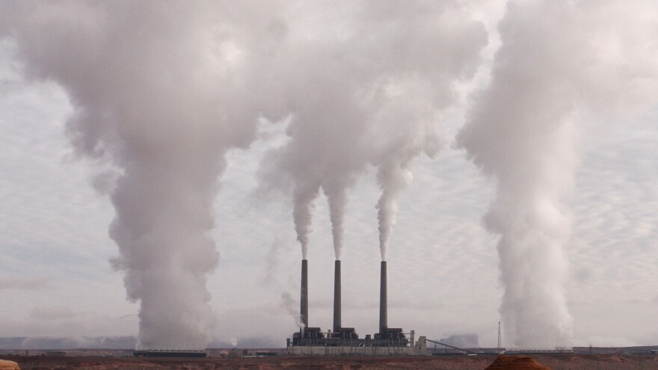
What are you breathing in?
By: Adrian Ramirez | Data Analyst

Slide 2
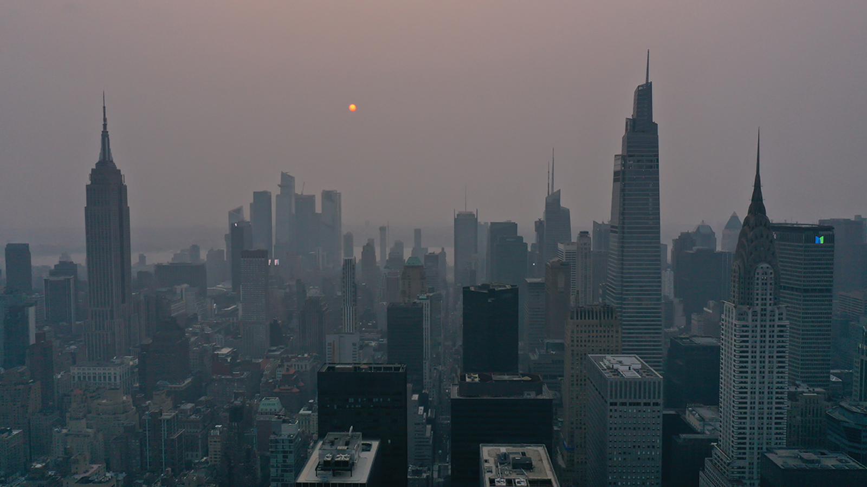
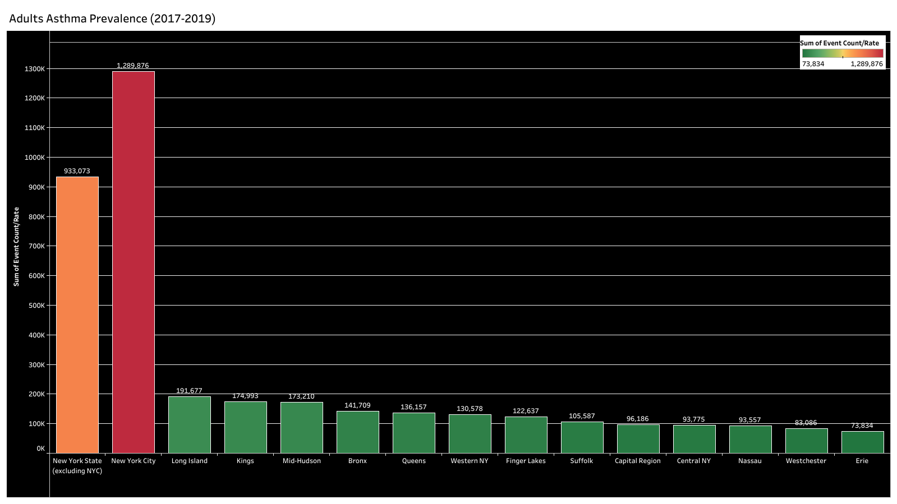
Asthma Prevalence in Adults
Did you know NYC alone has more Asthma cases than the rest of State combined.
NYS has the highest Asthma prevalence in the country.
Why is this?
What are you breathing in?

Slide 3
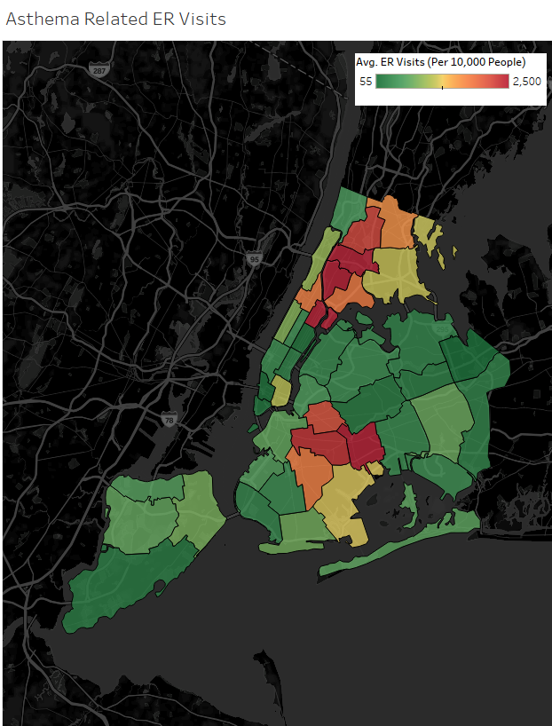
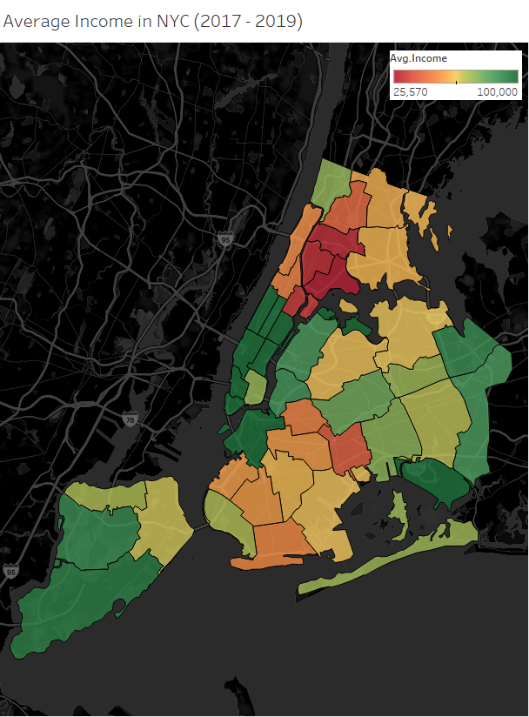
Asthma In NYC (Per 10k People)

Slide 4
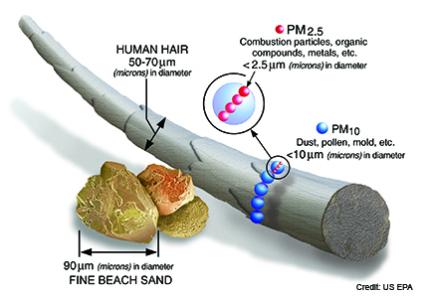
What’s In The Air? (Fine Particulate Matter or PM2.5)
They are very small airborne particles less than 2.5 microns in diameter.
UG/M³ = Micrograms per cubic meters
Levels below 12 UG/M³ is healthy.
13 - 35 UG/M³ is unhealthy.
35 – 50+ UG/M³ is dangerous.

Slide 5
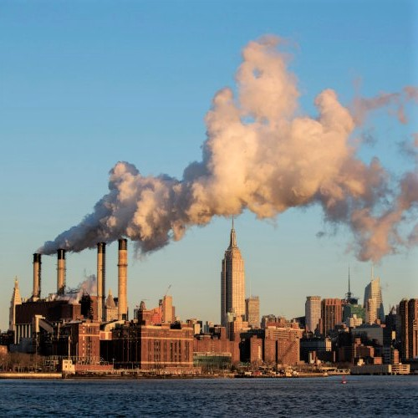
What’s In The Air? (Black Carbon)
A type of Particulate Matter which is a black sooty material emitted from engines and the burning of fossil fuels.
Makes up about 20% of Fine Particulate Matter in NYC.
A major contributor to climate change.

Slide 6
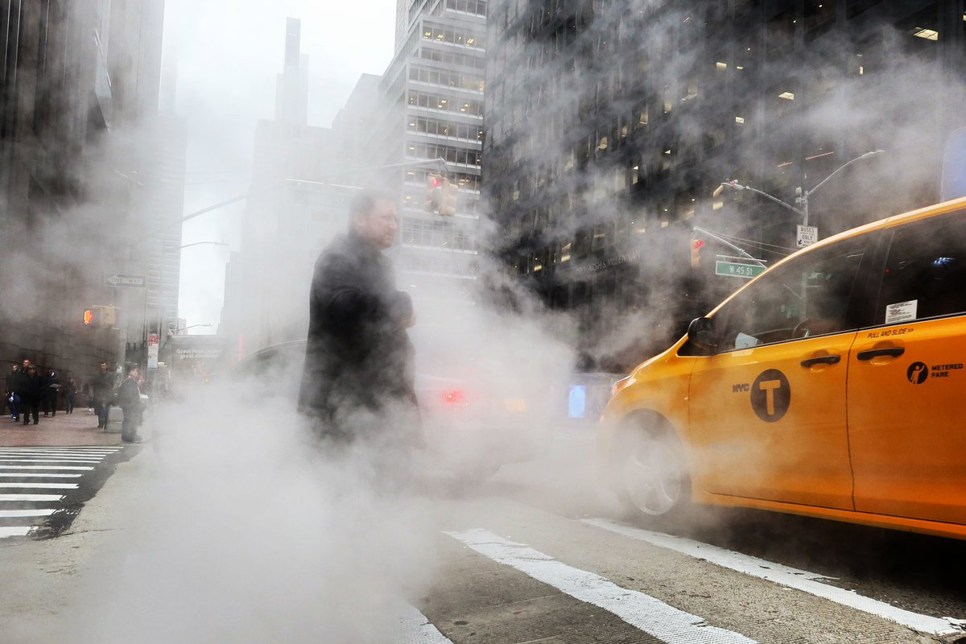
What’s In The Air? (Nitric Oxide & Nitrogen Dioxide)
A group of pollutants known as Oxides of Nitrogen.
Exposure to this is linked to emergency visits and hospitalizations for respiratory illnesses.
PPB = Parts per billion
Levels below 25 ppb is healthy.
25-50 is unhealthy.
50 + is dangerous.

Slide 7
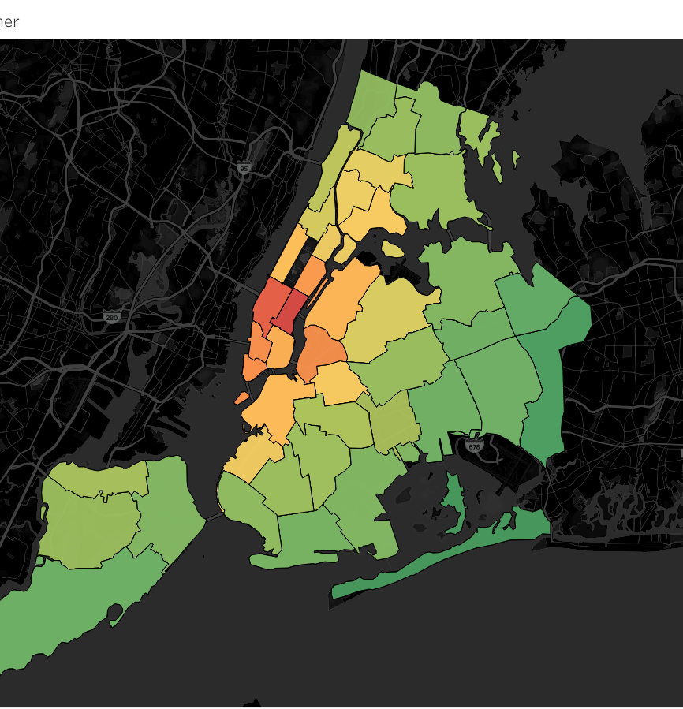
Particulate Matter in NYC (U/GM³)
The primary concentration of PM2.5 is in Midtown Manhattan.
High to Moderate levels are spread around in areas such as:
Lower Manhattan
Lower East Side
Long Island City
Williamsburg
Link to the Tableau Workbook for the interactive map

Slide 8
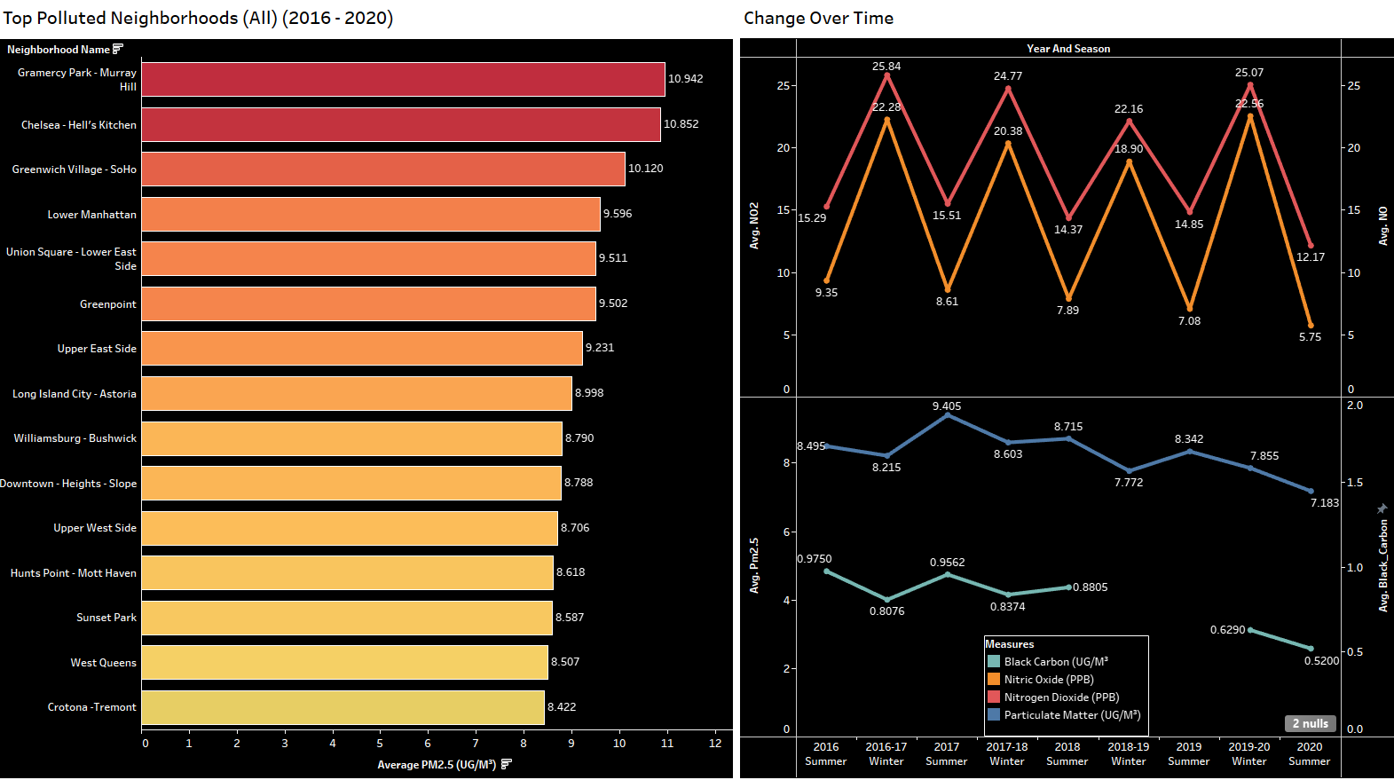
Change Over Time & Top Polluted Neighborhoods
The top 5 neighborhoods with the highest levels of PM2.5 are all in Manhattan.
Higher levels of NO & NO2 occur in the winter.
Higher Levels of PM2.5 & Black Carbon occur in the Summer.

Slide 9

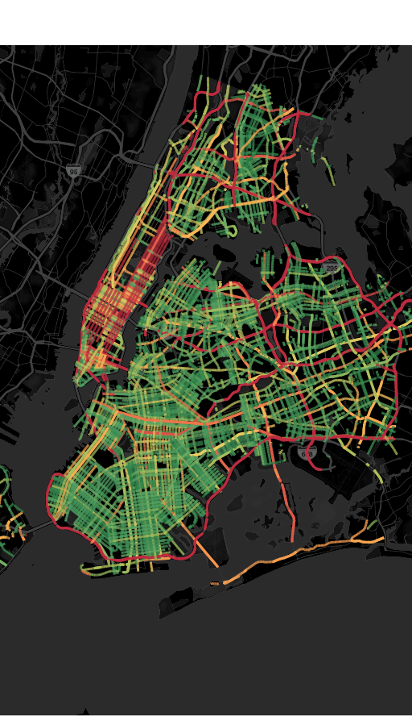
Car Volume In NYC
Link to the Tableau Workbook for the interactive map

Slide 10
What do we know?
The COVID lockdown significantly reduced levels of air pollutants.
Summer is when Particulate Matter is at its highest point.
Winter is when NO & NO₂ levels are at their highest.
Manhattan has the highest average levels of air pollution out the 5 boroughs.

Slide 11
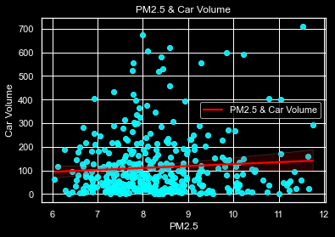
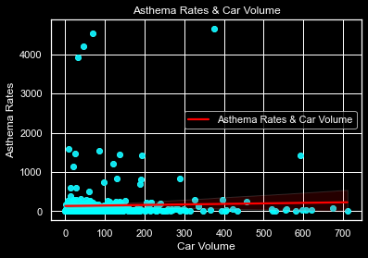
Is there a Correlation?
Somewhat
Yes

Slide 12
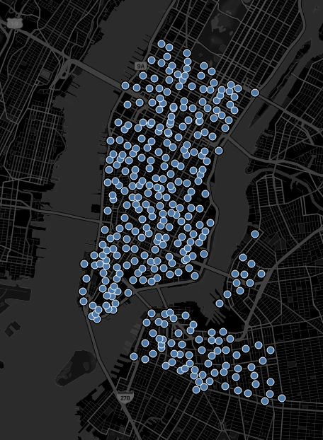
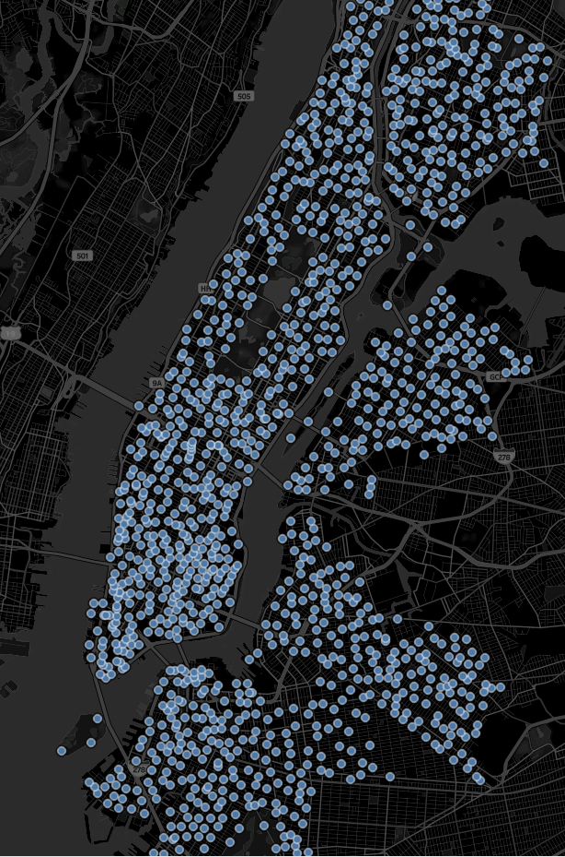
Recommendations
Transition to more efficient, less polluting vehicles.
Reduce fossil fuel combustion in buildings.
Use public transportation.
Ride a bike or walk, it’s healthier.
Citibike Stations
2013
2022

Slide 13

Datasets Used
Department of City Planning, LION Single Line Street Base Map, LION; retrieved from https://www1.nyc.gov/site/planning/data-maps/open-data/dwn-lion.page.
Department of Transportation, NYC Open Data, Automated Traffic Volume Counts; retrieved from https://data.cityofnewyork.us/Transportation/Automated-Traffic-Volume-Counts/7ym2-wayt.
NYC Health, Environmental & Health Data Portal, Air Quality (2016-2020), Asthma (2017-2019); retrieved from https://a816-dohbesp.nyc.gov/IndicatorPublic/BuildATable.aspx.
Citibike System Data, Citibike Trip History Data, Citibike-tripdata (06/13), Citibike-tripdata(05/22); retrieved from https://ride.citibikenyc.com/system-data

Slide 14
Project Steps
Process:
Data
Exploration
Data Analysis
Presentation
Merging Data (SQL / PY)
Data Cleaning (PY, Excel)
Data Validation (SQL)
Visualizations (PY, Tableau)
- Constructing Maps (DOT / LION, Tableau)
Present (PowerPoint, Tableau)

Slide 15



Thank You!
Adrian Ramirez | Data Analyst
Email: Adrian.r19970@gmail.com
LinkedIn: www.linkedin.com/in/adrian-ram970
Project: Tableau Workbook

